Slide 2
Build intelligent apps with the Microsoft data platform
Rohan Kumar
General Manager, Data Systems Group
@RohanKSQL
#MSFTConnect
Notes:
It’s so great to be back at Connect.
Before we get started, I have my team online to answer any questions that come up during the presentation. Just tweet using @RohanKSQL.
I’m so excited to be here today with all of you in the room and our 2 million viewers online. As a developer myself, coming to Connect always feels a little like coming home for me.
It’s amazing to experience, firsthand, the pace of innovation we are seeing in app development at every level– from in-database performance innovations and cognitive experiences, to using APIs to execute.
[Transition] When I started as a developer, my tools looked a little bit like this.

Slide 3
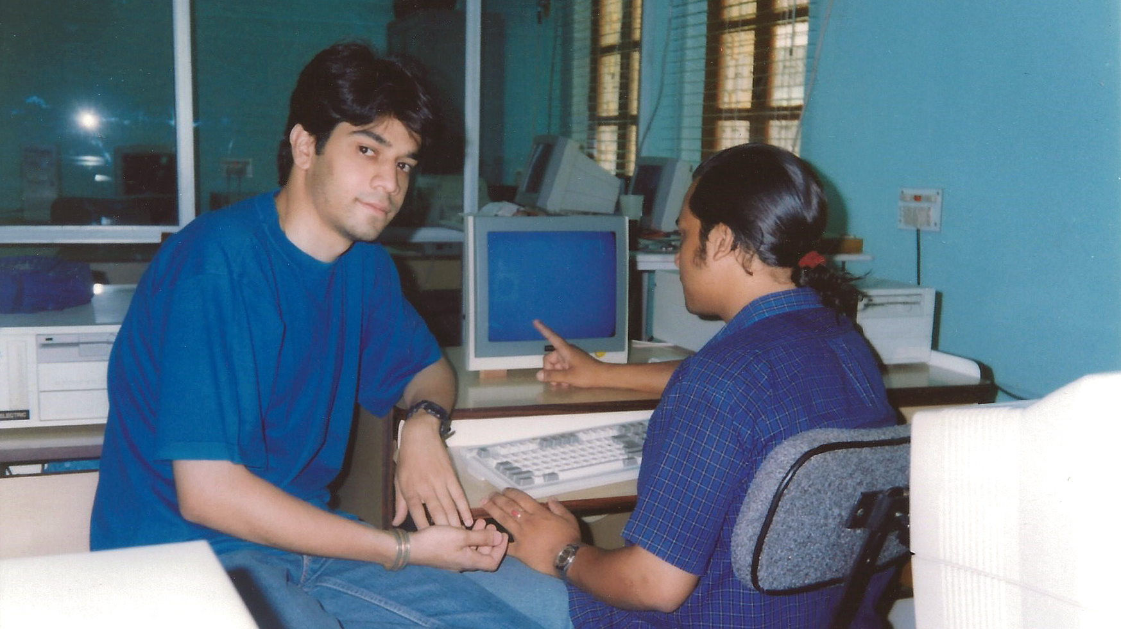

Slide 4

You are changing the world
Notes:
And this is all possible, thanks to developers like you who are changing the world – one algorithm at a time.
As we all know, the success of an app is deeply dependent on the volume and quality of data supporting it.
[Transition] Lucky for us, we’re experiencing exponential data growth that offers an untold wealth of information.

Slide 5
CLOUD
DATA
AI
Notes:
But data alone isn’t enough. You also need sophisticated cloud services for tremendous compute power and AI for smart analytics.
Taken in combination, these 3 trends are accelerating innovation the same way the internet accelerated information 20 years ago.
Remember back to the dawn of the commercial internet? No one could have predicted the impact it would have on our society or the way it would shape our everyday lives.
This is where we stand today in the world of app development. Data, cloud and AI together have the potential to transform our world.
[Transition] We’re limited only by our imagination, our creativity and our ability to tame this new world of data with the disruptive apps we build.

Slide 6
Disruptive apps
Notes:
Take Jet.com, right? They’re going head to head with the online retail giants of our time.
What are they doing differently? Their secret to success comes down to a WHOLE lot of data and some great algorithms.
By being able to execute code in real-time – as their customers place items in their carts – they can determine the best prices across the internet.
And BOOM. It’s a whole new way to sell online.
This kind of change isn’t just happening in consumer apps, either. You’ve seen advancements like this in line of business applications as well.
Soon every application will be an intelligent application.
[Transition] However, in order to build apps this agile and intelligent, you need a supporting data system complete with databases, analytics and BI.

Slide 7
Integrated data platform
Enable you to innovate
Notes:
The more integrated these data experiences are to each other, the faster your app can unlock the power of the data behind it.
The faster you can innovate.
The faster you can deliver experiences to your users.
The faster you can discover new worlds.
[Transition] My team and I aspire to make it easy and seamless for you to integrate data in your app building process and get the insights you need.

Slide 8
Integrated data systems
Enable you to innovate
Hybrid
Open
Intelligent
Notes:
We want to enable you to take advantage of data to innovate faster, to deliver new experiences and improve the world we live in.
We dream of creating a data system that works the way you want it to. That makes it seamless for you to –
Support open & hybrid cloud scenarios.
Embed data-driven intelligence in the app.
Enable cross-device customer experiences.
All while allowing for continuous innovation.
[Transition] We do this by closely integrating our data services, to ensure a supporting data system for your apps that is hybrid, open, and intelligent.

Slide 9
Enable you to innovate
Hybrid
Open
Intelligent
Notes:
HYBRID enables you to leverage the best-of-class solutions in cloud as well as on-premises. It helps you move your apps forward faster and pivot gracefully.
OPEN is our promise to continue bringing open source data offerings to Azure that complement how you work.
And INTELLIGENT – as you heard earlier in the AI session – is our way of saying we want to bring intelligence closer to the database to make it easier for you to integrate AI and analytics.
[Transition] Let's dive in deeper and how our investments in these areas translate into actual products and services.

Slide 10
SQL SERVER 2017
ON LINUX, Docker, And Windows Server
Notes:
We recently announced general availability of SQL Server 2017. This version has a lot of exciting capabilities built-in that were designed with developers in mind!
You can now run SQL Server 2017 on Linux and Docker containers as well as Windows Server for production workloads.
We’ve even updated the drivers to support all your favorite development languages such as Java, Python, Ruby, node.js, PHP, and more.
[Transition] While we continue to keep the goodness of SQL Server that you love, you’ll notice other major enhancements in this new release as well.

Slide 11
SQL SERVER 2017
Support for graph data and queries
Advanced Machine Learning with R & Python
Native T-SQL scoring
Adaptive Query Processing and Automatic Plan Correction
Consistent surface area across editions
Microsoft SQL Operations Studio
Notes:
SQL Server 2017 now has….
Support for graph data and queries
Advanced Machine Learning with R & Python
Native T-SQL scoring
Adaptive Query Processing and Automatic Plan Correction
Microsoft SQL Operations Studio
And that’s just the tip of the iceberg.
[Transition] It’s exciting to see how these SQL Server innovations are already helping companies out there reimagine their businesses.

Slide 12

dv01
Notes:
For example, dv01 - a financial technology company based here in New York – moved to SQL Server 2017 from a competing platform.
Amongst other benefits, they saw improved performance results – with query time going down from 30 seconds to 1-2 seconds to enable close to real time analytics for their users.
I’m excited that Dean Chen, the development lead of dv01 is here.
[Transition] Dean, please join me on stage
http://customers.microsoft.com/en-us/story/dv01

Slide 13
DEMO SQL Server 2017
Dean Chen VP of Engineering, dv01
Notes:
Thank you Dean for demonstrating how you’re using SQL Server in Linux and Docker containers to innovate faster than ever.
[Transition] While SQL Server is a great database, we know many of you are looking for fully managed database in the cloud.

Slide 14
Journey to the cloud
Seamless and reliable migration at scale
Lift and shift to the cloud with no code changes
Maximize current on-premises license investments
Azure SQL Database
Azure Database Migration Service
SQL Server
Notes:
The fully-automated Azure Database Migration Service allows you to lift and shift your on-premises SQL Servers and Oracle…
…to an Azure SQL Database Managed Instance with a surface area like an on-premises SQL Server, but the maintenance and administration benefits of Azure SQL DB.
The Azure Hybrid Benefit maximizes your existing investments in on-premises licenses with discounted rates on Managed Instance.
These new services and offers give you more freedom in your choice about where and how.
watch for the public preview announcement coming later this fall

Slide 15
introducing
Azure database migration service PREVIEW
Notes:
We recently announced general availability of SQL Server 2017. This version has a lot of exciting capabilities built-in that were designed with developers in mind!
You can now run SQL Server 2017 on Linux and Docker containers as well as Windows Server for production workloads.
We’ve even updated the drivers to support all your favorite development languages such as Java, Python, Ruby, node.js, PHP, and more.
[Transition] While we continue to keep the goodness of SQL Server that you love, you’ll notice other major enhancements in this new release as well.

Slide 16
AZURE SQL DATABASE
Automatic performance tuning
Insights at scale
Automatic threat detection
Vulnerability assessment
Native T-SQL scoring
Notes:
Azure SQL database brings your familiar SQL Server into the cloud as a highly intelligent automated service.
In addition to being fully managed, Azure SQL database offers built-in intelligence that learns your app as it runs. The database adapts its environment to optimize for your app behavior and reduce your costs by:
Scaling on the fly
And maximizing performance without over-provisioning resources.
Like all Azure services, SQL Database offers trusted certifications and provides the highest levels of privacy with built-in features like Always Encrypted.
If you haven’t checked out Azure SQL Database in a while, you might be pleasantly surprised by some of the great enhancements we’ve made, like:
automatic plan corrections with adaptive query processing
support for SQL Graph data
and intelligent threat detection.
It’s a great place to build apps because we’re constantly adding innovative features. Right now, in preview, we have:
Insights at scale
Seamless compatibility with on-premises deployments through managed instance
[Transition] All told, Azure SQL database is a serious and smart work horse of a database.

Slide 17
DEMO Azure SQL Database
Joanne Marone Director, Product Marketing
Notes:
Thanks Joanne! That was awesome!
[Transition] SQL Server 2017 and Azure SQL DB are great if you’re building in SQL, but what if you are using some other database?

Slide 18
AZURE Database services FOR MYSQL AND POSTGRESQL
Community PostgreSQL and MySQL
Scale with near zero downtime
Built-in high availability with SLAs
Easily build intelligent apps
Notes:
We want to support the app you want to build. That’s why we offer database services for MySQL, PostgreSQL
Azure Database services for PostgreSQL and MySQL are community version of these database engines complemented with fully managed service capabilities in Azure.
This means you get a fully managed service for your open source database and a deep connection with other Azure services like Power BI.
Plus you get trusted Azure features, like high-availability, elastic scalability, security, and recovery – built in, at no extra cost.
Since announcing preview earlier this year, we have been adding new features, including new compute tiers, as well expanding availability across the world. It’s available today in a Standard Tier in 16 regions.
[Transition] These services are still pretty new, but we’ve been excited about the customer enthusiasm that we’ve seen during the preview period.

Slide 19
Fotoable
Notes:
Take for instance, Fotoable. Fotoable is an extremely successful start-up, based in China. It makes mobile apps for creative photos. It’s been ranked among the top 15 for the most downloads with more than 600 million users worldwide.
To support their rapid expansion and surge in demand, they needed scalability, high-availability, security and global availability.
They chose Azure Database for MySQL for its unique performance capabilities and grace under fire – and bet their growth on us.
It’s a great honor for us when any company of any size chooses our platform. We understand how much is at stake for our customers, from big enterprises to new start-ups, and we’re grateful to partner with you all.
http://customers.microsoft.com/en-us/story/fotoable
[Transition] I’d like to share with you some of the capabilities that are driving the customer momentum and excitement we’ve seen for these new open source services.

Slide 20
DEMO Azure Database for PostgreSQL
Rachel Agyemang Program Manager
Notes:
Please welcome Rachel to demo Azure PostgreSQL Database
Thanks Rachel, that was amazing!
[Transition] And we are now excited to announce that we will bring the same advantages that your see with Postgres and MySQL on Azure – to MariaDB.

Slide 21
Joining the MariaDB foundation
INTRODUCING
Azure database for MariaDB
Notes:
As Scott announced earlier today, we are joining the MariaDB foundation and are committed to working closely with the community.
Ok.
So we’ve got you covered with SQL.
We’ve got you covered with PostgreSQL, MySQL and MariaDB.
[Transition] But what if you need something else. Something that is globally distributed and is specially designed to handle data challenges posed by modern global apps?

Slide 22


AZURE COSMOS DB
Turnkey global distribution
Multi-model with native NoSQL support
Elastically scale storage and throughput
Multiple, well-defined consistency levels
<10ms latency guarantees at the 99th percentile
Industry-leading SLAs
MongoDB
Azure Table Storage
Notes:
Microsoft Azure Cosmos database is a globally distributed database service that puts data where your app users are –wherever they are.
Azure Cosmos is a great choice when you need to handle more than one data model, and you want your choice of APIs.
The service guarantees milli-second latency and offers the best SLA’s in the industry.
Azure Cosmos DB is the only one of its kind to offer multiple, well-defined data consistency levels as turnkey choices. This allows you to fine tune the trade-offs you make between data consistency, latency and your app user’s experience with a few simple clicks.
It makes it faster and easier for you to get your global apps up and running and makes your apps more accessible and reliable for customers worldwide.
[Transition] And we continue to invest in this service adding more APIs – so you can work with your familiar technology.

Slide 23
Azure Cosmos DB
Introducing
Apache Cassandra API
Notes:
I’m happy to share with you that you can now run your Cassandra on Azure through the Azure Cosmos database Cassandra-as-a-service.
While you can do amazing things in any one of the databases we’ve discussed. The most interesting and revolutionary uses of these database services are actually occurring in apps that reach across databases.
[Transition] Customers who get the most from the Microsoft platform are those who leverage the integrated data experiences we uniquely support.

Slide 24




ASOS
Notes:
Take for example, the online fashion retailer Asos.
Asos takes full advantage of the Azure Platform to drive continuous growth and tame huge waves of seasonal demand.
By using Azure Cosmos database along with Azure SQL Database they stay ahead of the market place and scale easily to meet their customers’ needs.
[Transition] Let’s take an in-depth look at an end to end solution that we built by bringing together some of our key services.
http://customers.microsoft.com/en-us/story/asos-retail-and-consumer-goods-azure

Slide 25
DEMO Azure Cosmos DB and Azure SQL Database
Craig Kitteman Director, Product Marketing
Shreya Verma Senior Program Manager
Notes:
Our goal here was to coordinate their emergency response teams in order to improve patient care in life or death situations.
Please join me in welcoming Craig and Shreya up to the stage to demo how it works.
Rohan interacts with questions…..
Thanks Craig and Shreya, that’s amazing. I love to think we’re building databases that can help bring those types of apps to life.
As we saw in the demo – and you’ve seen through your own builds – apps require an ecosystem of services to make them really shine.
Not only do you need transactional databases that can respond to your requirements, but you need R Services and analytics to tease intelligence out of all that data. And on top of your analytics, you need BI to make data intelligence accessible to everyone.
We know the universe of app possibilities is continuing to grow through innovative solutions and services, and we’re so proud to be a part of it all.
[Transition] We want to continue to invest, not only in expanding our own services but in helping optimize other great services, in order to grow and strengthen the developer community at large.

Slide 26

introducing
Azure databricks
A fast, easy and collaborative Apache® Spark™ based analytics platform optimized for Azure
Notes:
Case in point, Scott Guthrie made the Azure Databricks announcement earlier today.
This has been a really exciting project for both sides of the partnership. But you don’t have to take my word for it.
[Transition] Ali, the CEO of Databricks is here in person.
Ali, would you please join me on stage to share your thoughts about the announcement and the journey of bringing Databricks to Azure.

Slide 27
WELCOME Azure Databricks
Ali Ghodsi Co-founder & CEO, Databricks
Notes:
Rohan: Tell us more about Azure Databricks.
Rohan: What is one highlight you would like to share.
[Transition] Azure Databricks is a great example of how the developer community at large is driving innovation and giving back to the community for the sake of knowledge and improvement. We are just so honored to be part of your community. Thank you.

Slide 28


Together we’re changing the world
Notes:
You know, I can imagine picking up a book one day, maybe not that long from now, and reading, “once upon a time, a bunch of people coded and they changed the world.”
It’ll be a story you’re all writing right now that will be filled with new discoveries and cures made possible by the work you do together.
I imagine this story will be as rich as this community here today and as creative as the apps you all dream up.
We’re dreaming too.
We hope in some small way our work will make it easier for you to
build the apps,
that change the world,
that write the stories we’ll read.
It’s all in the name of empowering your creativity.
Thanks so much for being part of the journey and let's stay in touch!

